Slide 1
RNA-seq Wrap-up
11/2/21
BIFX 504
Miranda M. Darby PhD

Slide 2
Goal: Identify robust changes in gene expression in psychiatric disease
Considerations:
Most GWAS loci are outside of coding regions = suspected eQTLs
Heterogeneity of gene expression
Many GWAS loci of small effect = rare or not penetrant
Look at gene expression in aggregate = Gene sets
Expression affected by cell type, signaling
Look at multiple brain regions
Sample heterogeneity
Complex disorders with spectrum of symptoms
Either refine or increase number of samples
Environmental variation
Either refine or increase number of samples
Many GWAS loci associate with multiple disorders
Look for shared changes across disorders to increase total number of samples
Look for shared changes across disorders to control for medications etc.
Notes:
Many previous studies have identified individual genes with expression changes in psychiatric disease that were not later replicated. For this reason we designed our analysis to identify the most robust and consistent patterns in gene expression associated with psychiatric disease.
Genome wide association studies have identified many loci of small effect that contribute to psychiatric disease risk. Since relatively few are in annotated coding sequences, most are thought to affect gene expression. If many loci of small effect perturb genes in the same pathway, their combined effect could be much greater. However, since some genomic elements can affect the expression of genes that are a great distance away, it is difficult to identify which genes may be perturbed. To make things more challenging, different genes are expressed in different brain regions, so the effect of each polymorphism may be tissue specific. On the other hand, many polymorphisms identified in GWAS associate with more than one disorder, so consistent changes in gene expression across disorders may validate results. In addition, expression differences that are consistent across disorders are less likely to be due to a particular medication or other factor.
Our approach was therefore to find canonical pathway gene sets with consistently perturbed expression in multiple disorders in more than one brain region.

Slide 3
Two Different Approaches
Gene Set Expression Analysis
Repetitive Element Loci
High sample-to-sample variability
Small expression differences
Different genes in different individuals
Genes in same pathway = same symptoms
Core deficits
Common across diagnoses
Common across brain regions
HG19 Repeat Database: 5,298,130 genomic regions
More than 50% of genome
Multiple copies of highly similar DNA sequences
Left over from transposition
Most immobilized
97% have unique region
Expressed in cortex but specific loci unknown
Might be functional
Notes:
Overexpression of Alu (retrotransposon) RNA causes toxicity in age related macular degeneration
Expression of HERV-W altered in schizophrenia, bipolar disorder, and depression

Slide 4
Methods Overview
Sequence RNA from large number of brains
Hippocampus or orbitofrontal cortex
SCZ, BPD, or MDD and matched controls
Align sequencing reads to genome
Count reads aligning to each gene
In each brain region, identify genes differentially expressed in each diagnostic group relative to control

Slide 5
Experimental Considerations
Sample selection and library prep
Sequencing depth and multiplexing
Assessing the quality of the resulting sequence reads
Genomic alignment versus abundance estimation
Detection of novel/unannotated transcripts
Quantification of genes/transcripts/exons
Differential expression analysis
Gene co-expression and gene set enrichment analysis

Slide 6
Experimental Considerations
Sample selection and library prep
Sequencing depth and multiplexing
Assessing the quality of the resulting sequence reads
Genomic alignment versus abundance estimation
Detection of novel/unannotated transcripts
Quantification of genes/transcripts/exons
Differential expression analysis
Gene co-expression and gene set enrichment analysis

Slide 7
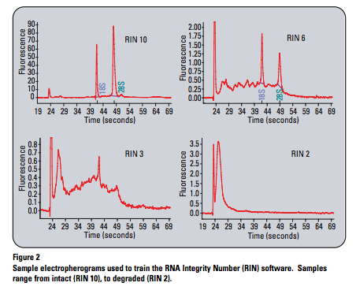
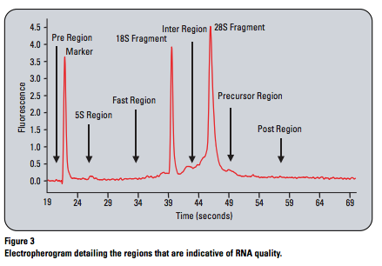
Quality control
RNA quality
RNA Integrity Number
Quality of library prep
Are there PCR duplicates?
Sequencing reads
PHRED scores
Percent mapped
Mapping technique
Quantification technique
Statistical inference method
https://www.agilent.com/en/product/automated-electrophoresis/bioanalyzer-systems/bioanalyzer-rna-kits-reagents/bioanalyzer-rna-analysis-228256

Slide 8
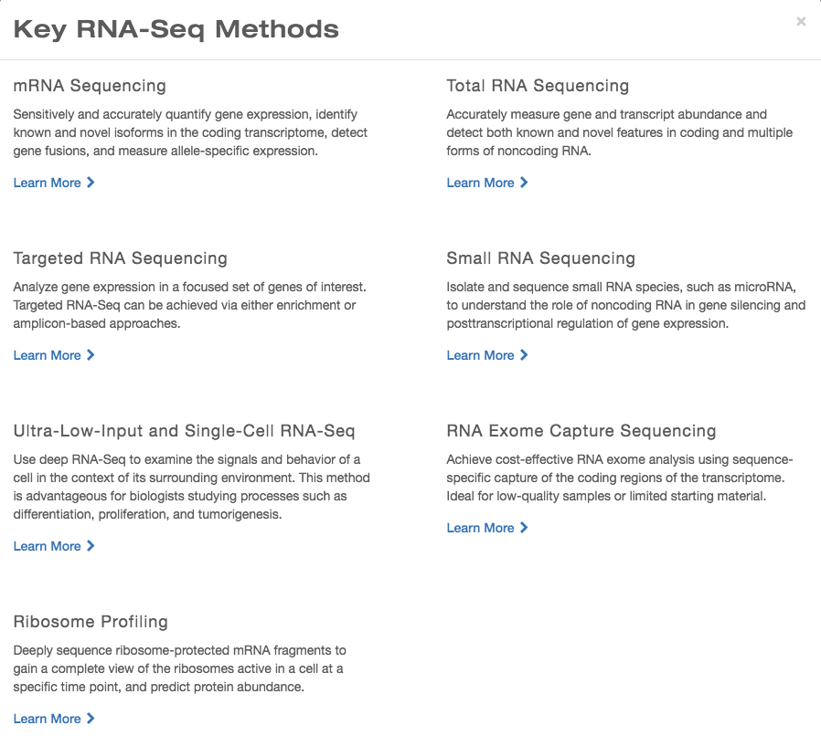
STRANDED vs UNSTRANDED
STRANDED vs UNSTRANDED
https://www.illumina.com/techniques/sequencing/rna-sequencing.html

Slide 9
Experimental Considerations
Sample selection and library prep
Sequencing depth and multiplexing
Assessing the quality of the resulting sequence reads
Genomic alignment versus abundance estimation
Detection of novel/unannotated transcripts
Quantification of genes/transcripts/exons
Differential expression analysis
Gene co-expression and gene set enrichment analysis

Slide 10

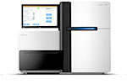
EXTRACTION
FRAGMENTATION
cDNA SYNTHESIS
Purified RNA
Fragmented RNA
Double Stranded cDNA
ADAPTER LIGATION
180 Million Short Reads
Adapter Ligated Libraries
ALIGN READS TO GENOME
ATTATCACTCGAAGTATGCCCATCTATCGATGACTCGAAGTAATTGCCCTATCGATGACTCGAAGTCTCGAAACTCGAAGTCTCGAAACTCGAAGTCTCGAAGTTTTTAGTTTTTGCCCTAT
AVERAGE NUMBER OF ALIGNED READS PER SAMPLE
ORBITOFRONTAL CORTEX: 140,000,000 SINGLE-END, 59 samples
HIPPOCAMPUS: 154,000,000 X 2 PAIRED-END, 102 samples

Slide 11
Experimental Considerations
Sample selection and library prep
Sequencing depth and multiplexing
Assessing the quality of the resulting sequence reads
Genomic alignment versus abundance estimation
Detection of novel/unannotated transcripts
Quantification of genes/transcripts/exons
Differential expression analysis
Gene co-expression and gene set enrichment analysis

Slide 12
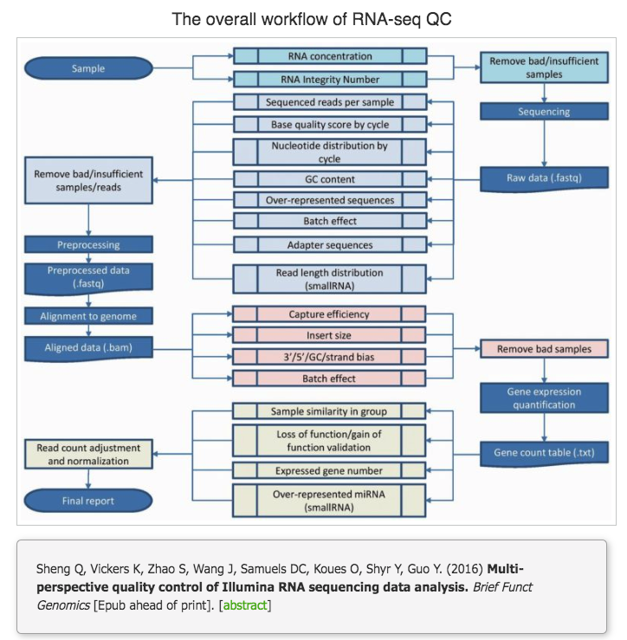
Quality control
Quality of library prep
Are there PCR duplicates?
Is there rRNA?
Sequencing reads
PHRED scores
Percent mapped

Slide 13
Experimental Considerations
Sample selection and library prep
Sequencing depth and multiplexing
Assessing the quality of the resulting sequence reads
Genomic alignment versus abundance estimation
Detection of novel/unannotated transcripts
Quantification of genes/transcripts/exons
Differential expression analysis
Gene co-expression and gene set enrichment analysis

Slide 15
Experimental Considerations
Sample selection and library prep
Sequencing depth and multiplexing
Assessing the quality of the resulting sequence reads
Genomic alignment versus abundance estimation
Detection of novel/unannotated transcripts
Quantification of genes/transcripts/exons
Differential expression analysis
Gene co-expression and gene set enrichment analysis

Slide 16
Two Different Approaches
Gene Set Expression Analysis
Repetitive Element Loci
High sample-to-sample variability
Small expression differences
Different genes in different individuals
Genes in same pathway = same symptoms
Core deficits
Common across diagnoses
Common across brain regions
HG19 Repeat Database: 5,298,130 genomic regions
More than 50% of genome
Multiple copies of highly similar DNA sequences
Left over from transposition
Most immobilized
97% have unique region
Expressed in cortex but specific loci unknown
Might be functional
Notes:
Overexpression of Alu (retrotransposon) RNA causes toxicity in age related macular degeneration
Expression of HERV-W altered in schizophrenia, bipolar disorder, and depression

Slide 17
Methods Overview
Align sequencing reads to genome
Count only reads that align uniquely in the genome
MQ40, 1:10,000
Count reads aligning to each repetitive element locus (RE)
Ensure that method works
Mapping of Y chromosome
Differential expression between blood and brain
Characterize RE expression
Look at transcripts—context of RE
Look across species
Look for association with translating ribosomes

Slide 18
RE Expression on Y Chromosome

Slide 19
Differential Expression of RE

Slide 20
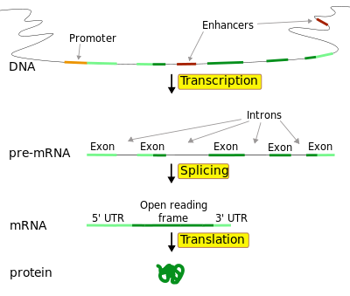
Location of Expressed Repeats
Transcribed Gene
Sense Direction:
Notes:
Exons: ~1.5 % of Genome
Introns: ~ 5% of Genome
Most of Genome is Intergenic
Majority of GWAS hits are in intergenic regions

Slide 21
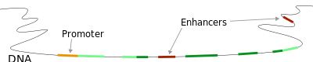
Intergenic Repeat Element Expression
Intergenic
10405 expressed repeats (33% of total) are intergenic
Notes:
The majority of schizophrenia GWAS hits are far from annotated genes, so we were interested to see expression from more than 10,000 intergenic repeats. Around 1/3 of the differentially expressed repeats were in intergenic regions
Exons: ~1.5 % of Genome
Introns: ~ 5% of Genome
Most of Genome is Intergenic
Majority of GWAS hits are in intergenic regions

Slide 22
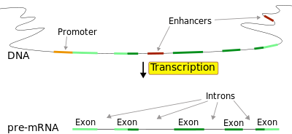
Repeat Elements Expressed in Genes
Transcribed Gene
Sense Direction:
Roughly 2/3 of expressed repeats are transcribed in the sense direction in genes
14,055 in exons
7,228 in introns
Notes:
The majority of expressed repeats were transcribed in the sense direction within exons or introns. Since introns are immediately spliced out and degraded, sequencing reads aligning to intronic repeat elements are especially interesting, since they suggest that these repeats may be retained part of the final gene product or as transcribed as independent transcript.
Exons: ~1.5 % of Genome
Introns: ~ 5% of Genome
Most of Genome is Intergenic
Majority of GWAS hits are in intergenic regions

Slide 23
Identification of novel splicing patterns = new transcript isoforms
Canonical
Novel
Red = Aligns continuously, Purple = Crosses splice junction #1, Blue = Crosses splice junction #2

Slide 24
Quantitative PCR Test of Transcript Isoform Abundance

Slide 25
PCR Confirmation of Novel Transcript Isoforms

Slide 26
PCR Confirmation of Novel Transcript Isoforms

Slide 27
Splicing of an Intronic LINE into PPP2R5C

Slide 28
PCR Confirmation of Novel Transcript Isoforms

Slide 29
Splicing of an Intergenic SINE to Create an Alternative Start For RPL23

Slide 30
PCR Confirmation of Novel Transcript Isoforms

Slide 31
Splicing of an Intergenic SINE to Create an Alternative 3’ For HSD11B1L

Slide 32
Reconstruction of a Full Transcript with an Intronic RE

Slide 33
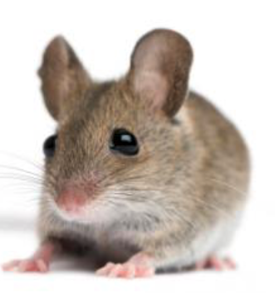
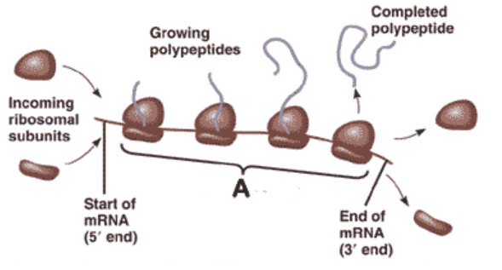
Novel Splicing Isoforms with Intergenic or Intronic RE are Translated in Mice

Slide 34
Conclusions
RE are abundantly expressed in the OFC
Some RE represent alternative start sites or termination sites of mRNAs
Some expressed RE contribute to novel splicing isoforms of mRNAs
Some of the novel isoforms are likely to produce new protein isoforms while others will trigger quality control mechanisms
Notes:
In conclusion, we have identified functionally related sets of genes that are concordantly overexpressed or underexpressed in the hippocampus and orbitofrontal cortex in schizophrenia, bipolar disorder, and major depression.
Many of the processes described by these gene sets--such as neuronal systems, GABAergic signaling, and adaptive immunity--have previously been implicated in at least one disorder, but we now provide evidence that expression of these genes is perturbed in all three disorders.
Our findings also highlight potential roles for mRNA processing and translation in schizophrenia, bipolar disorder, and major depression.
In the future it would be interesting to reexamine GWAS results in the context of the concordantly regulated pathways that we have identified to see whether any of the polymorphisms that associate with multiple psychiatric disorders correlate with expression of these sets of genes.
I am also very interested to examine the causes of ribosomal overexpression and the potential effects on mRNA processing and translation. In particular, mRNA processing functions such as nonsense mediated decay (which identifies and degrades transcripts with erroneous stop codons) may contribute to psychiatric disease.

Slide 35
Future Directions
Are novel transcripts are translated in humans
Look to see which spliced RE mRNAs associate with ribosomes in humans
Search available protein databases for novel protein isoforms
Validate using antibodies to putative proteins
Are there other novel exons that are not RE?
Look at the extent of non-RE splicing in the same data
Look at novel splicing isoforms in other contexts
Are the novel isoforms implicated in psychiatric disease
Look for differential expression of RE in psychiatric disease
Look to see whether RE overlap GWAS sites
Notes:
In conclusion, we have identified functionally related sets of genes that are concordantly overexpressed or underexpressed in the hippocampus and orbitofrontal cortex in schizophrenia, bipolar disorder, and major depression.
Many of the processes described by these gene sets--such as neuronal systems, GABAergic signaling, and adaptive immunity--have previously been implicated in at least one disorder, but we now provide evidence that expression of these genes is perturbed in all three disorders.
Our findings also highlight potential roles for mRNA processing and translation in schizophrenia, bipolar disorder, and major depression.
In the future it would be interesting to reexamine GWAS results in the context of the concordantly regulated pathways that we have identified to see whether any of the polymorphisms that associate with multiple psychiatric disorders correlate with expression of these sets of genes.
I am also very interested to examine the causes of ribosomal overexpression and the potential effects on mRNA processing and translation. In particular, mRNA processing functions such as nonsense mediated decay (which identifies and degrades transcripts with erroneous stop codons) may contribute to psychiatric disease.

Slide 36
Demographic information for samples included in expression analysis
Stanley Array Collection
Stanley Neuropathology Consortium
 | Hippocampus |  |  | Orbitofrontal Cortex
Factor | SCZ | BPD | Controls | SCZ | BPD | MD | Controls
Number | 35 | 33 | 32 | 13 | 14 | 15 | 15
Age | 42.6 | 45.4C | 43.9 | 44.65 | 41.9 | 46.5 | 48.1
 | (19-59) | (19-64) | (31-60) | (25-62) | (25-61) | (30-65) | (29-68)
Sex | 9F, 26M | 18F, 15M | 9F, 24M | 8M, 5F | 9M, 5F | 9M, 6F | 9M, 6F
Race | 34C, 1H | 32C, 1NA | 32C | 10C, 3A | 13C, 1AA | 15C | 14C, 1AA
PMI (h) | 31.4 | 38 | 30 | 35.8 | 30.9 | 27.5 | 23.7
 | (9-80) | (12-84) | (9-58) | (12-61) | (13-62) | (7-47) | (8-42)
pH | 6.5 | 6.4 | 6.6 | 6.2 | 6.2 | 6.2 | 6.3
 | (5.9-6.9) | (5.8-7) | (6-7) | (5.8-6.6) | (5.8-6.5) | (5.8-6.5) | (5.8-6.6)
Side | 17L, 18R | 18L, 15R | 15L, 17R | 8L, 5R | 6L, 8R | 9L, 6R | 8L, 7R
100 total
57 total
Notes:
As Sarven mentioned, we sequenced RNA from the hippocampus of brains in the Stanley Microarray Collection and from the orbitofrontal cortex of brains in the Stanley Neuropathology Consortium. I’m sure that you are all familiar with these collections, so I will simply mention that after outlier removal we included 100 hippocampal samples and 57 orbitofrontal cortex samples in the final analysis and the controls remained well matched to each diagnostic group

Slide 37
 | Hippocampus |  |  | Orbitofrontal Cortex
Factor | SCZ | BPD | Controls | SCZ | BPD | MD | Controls
Number | 35 | 33 | 32 | 13 | 14 | 15 | 15
Age | 42.6 | 45.4 | 43.9 | 44.7 | 41.9 | 46.5 | 48.1
 | (19-59) | (19-64) | (31-60) | (25-62) | (25-61) | (30-65) | (29-68)
Sex | 9F, 26M | 18F, 15M | 9F, 24M | 8M, 5F | 9M, 5F | 9M, 6F | 9M, 6F
Race | 34C, 1H | 32C, 1NA | 32C | 10C, 3A | 13C, 1AA | 15C | 14C, 1AA
PMI (h) | 31.4 | 38 | 30 | 35.8 | 30.9 | 27.5 | 23.7
 | (9-80) | (12-84) | (9-58) | (12-61) | (13-62) | (7-47) | (8-42)
pH | 6.5 | 6.4 | 6.6 | 6.2 | 6.2 | 6.2 | 6.3
 | (5.9-6.9) | (5.8-7) | (6-7) | (5.8-6.6) | (5.8-6.5) | (5.8-6.5) | (5.8-6.6)
Side | 17L, 18R | 18L, 15R | 15L, 17R | 8L, 5R | 6L, 8R | 9L, 6R | 8L, 7R
No
Antipsychotics
Notes:
Not Addicts

Slide 38
Increased Expression
Most Significant
Upregulated
Most Significant
Downregulated
Decreased Expression
Notes:
We then ranked all genes according to the strength and direction of differential expression using the wald test statistic provided by DESeq2. The most significant genes with increased expression are at the top of the list while the most significant genes with decreased expression are at the bottom of the list. We performed gene set enrichment analysis to identify canonical pathway gene sets with a disproportionate number of genes at the top or bottom of each list.

Slide 39
Genes differentially expressed in the hippocampus in SCZ and BPD
 | All | Schizophrenia Vs Control |  |  |  |  | Bipolar Disorder Vs. Control
Gene | Counts | log₂FC | lfcSE | wald | pvalue | MTC p | log₂FC | lfcSE | wald | pvalue | MTC p
LOC100131257 | 219.38 | 0.41 | 0.08 | 5.43 | 5.52E-08 | 9.06E-04 | 0.1 | 0.07 | 1.38 | 1.69E-01 | 1
LOC100288637 | 309.86 | -0.38 | 0.08 | -4.94 | 7.80E-07 | 4.27E-03 | -0.31 | 0.08 | -4.06 | 4.92E-05 | 0.12
KIF19 | 1732.95 | 0.46 | 0.09 | 5.01 | 5.50E-07 | 4.27E-03 | 0.18 | 0.09 | 1.97 | 4.88E-02 | 1
SLC11A1 | 304.43 | 0.42 | 0.09 | 4.77 | 1.82E-06 | 7.48E-03 | 0 | 0.09 | 0.04 | 9.67E-01 | 1
FKBP5 | 2769.46 | 0.41 | 0.09 | 4.34 | 1.40E-05 | 3.29E-02 | 0.29 | 0.09 | 3.12 | 1.78E-03 | 0.88
GNA14 | 599.69 | 0.38 | 0.09 | 4.35 | 1.36E-05 | 3.29E-02 | 0.07 | 0.09 | 0.78 | 4.35E-01 | 1
LOC100188947 | 150.82 | 0.35 | 0.08 | 4.41 | 1.01E-05 | 3.29E-02 | 0.11 | 0.08 | 1.38 | 1.68E-01 | 1
HSPA7 | 867.94 | -0.28 | 0.07 | -4.21 | 2.54E-05 | 3.94E-02 | -0.26 | 0.06 | -4.09 | 4.38E-05 | 0.12
SVEP1 | 715.2 | 0.38 | 0.09 | 4.24 | 2.27E-05 | 3.94E-02 | 0.29 | 0.09 | 3.27 | 1.08E-03 | 0.71
MT1X | 5020.4 | 0.37 | 0.09 | 4.2 | 2.64E-05 | 3.94E-02 | 0.21 | 0.09 | 2.36 | 1.83E-02 | 1
S100A8 | 92.33 | 0.21 | 0.05 | 4.23 | 2.36E-05 | 3.94E-02 | 0.03 | 0.05 | 0.64 | 5.22E-01 | 1
NR4A2 | 1860.74 | -0.37 | 0.09 | -3.97 | 7.16E-05 | 9.80E-02 | -0.29 | 0.09 | -3.1 | 1.92E-03 | 0.89
RPPH1 | 1246.73 | -0.01 | 0.07 | -0.18 | 8.60E-01 | 1 | 0.48 | 0.06 | 7.39 | 1.51E-13 | 3.29E-09
SCARNA2 | 192.55 | -0.01 | 0.06 | -0.11 | 9.15E-01 | 1 | 0.35 | 0.06 | 6.12 | 9.48E-10 | 1.04E-05
CDR1 | 2177.67 | 0.02 | 0.08 | 0.23 | 8.20E-01 | 1 | 0.48 | 0.08 | 5.88 | 4.08E-09 | 2.97E-05
PAR5 | 333.34 | 0.08 | 0.09 | 0.89 | 3.73E-01 | 1 | 0.47 | 0.09 | 5.42 | 5.82E-08 | 3.18E-04
RMRP | 604.09 | -0.01 | 0.05 | -0.28 | 7.81E-01 | 1 | 0.23 | 0.05 | 5.12 | 2.98E-07 | 1.30E-03
MTRNR2L6 | 9.75 | 0.06 | 0.07 | 0.93 | 3.52E-01 | NA | 0.3 | 0.06 | 4.72 | 2.37E-06 | 8.63E-03
MUC16 | 10.41 | 0 | 0.04 | -0.1 | 9.24E-01 | NA | 0.17 | 0.04 | 4.18 | 2.96E-05 | 9.24E-02
Notes:
Genes differentially expressed in the hippocampus in schizophrenia and bipolar disorder. Counts=average number of normalized read counts per sample; log₂FC = log₂ transformed fold change; lfcSE = standard error of the log₂ transformed fold change; wald= test statistic for differential expression; pvalue = nominal p value of differential expression; MTC p = adjusted p value after multiple testing correction.

Slide 40
Genes Significant in One Brain Region and Nominally Significant in Same Disorder in Other Brain Region
Table S3: Genes differentially expressed in the hippocampus.
 | Hippocampus |  |  |  |  |  |  |  |  |  |  | Orbitofrontal Cortex
 | All | Schizophrenia Vs Control |  |  |  |  | Bipolar Disorder Vs. Control |  |  |  |  | All | Schizophrenia Vs Control |  |  |  |  | Bipolar Disorder Vs. Control |  |  |  |  | Major Depression Vs Control
Gene | Counts | Log₂FC | lfcSE | stat | pvalue | padj | Log₂FC | lfcSE | stat | pvalue | padj | Counts | Log₂FC | lfcSE | stat | p value | padj | Log₂FC | lfcSE | stat | p value | padj | Log₂FC | lfcSE | stat | p value | padj
LOC100131257 | 219.38 | 0.41 | 0.08 | 5.43 | 5.52E-08 | 9.06E-04 | 0.10 | 0.07 | 1.38 | 1.69E-01 | 1 | 1.91 | -0.01 | 0.11 | -0.06 | 0.95 | 1 | -0.03 | 0.11 | -0.23 | 0.82 | NA | 0.16 | 0.11 | 1.46 | 0.14 | NA
LOC100288637 | 309.86 | -0.38 | 0.08 | -4.94 | 7.80E-07 | 4.27E-03 | -0.31 | 0.08 | -4.06 | 4.92E-05 | 0.12 | 12.68 | -0.10 | 0.23 | -0.44 | 0.66 | 1 | -0.22 | 0.23 | -0.94 | 0.35 | NA | -0.10 | 0.24 | -0.41 | 0.68 | NA
KIF19 | 1732.95 | 0.46 | 0.09 | 5.01 | 5.50E-07 | 4.27E-03 | 0.18 | 0.09 | 1.97 | 4.88E-02 | 1 | 75.76 | 0.35 | 0.25 | 1.41 | 0.16 | 1 | 0.64 | 0.25 | 2.59 | 9.65E-03 | 0.18 | 0.62 | 0.25 | 2.50 | 1.00E-02 | NA
SLC11A1 | 304.43 | 0.42 | 0.09 | 4.77 | 1.82E-06 | 7.48E-03 | 0.00 | 0.09 | 0.04 | 9.67E-01 | 1 | 44.47 | 0.46 | 0.24 | 1.88 | 6.00E-02 | 1 | 1.07 | 0.25 | 4.35 | 1.38E-05 | 0.02 | 0.45 | 0.25 | 1.80 | 7.00E-02 | NA
FKBP5 | 2769.46 | 0.41 | 0.09 | 4.34 | 1.40E-05 | 3.29E-02 | 0.29 | 0.09 | 3.12 | 1.78E-03 | 0.88 | 155.92 | 0.31 | 0.24 | 1.32 | 0.19 | 1 | 0.94 | 0.24 | 3.94 | 8.05E-05 | 0.04 | 0.10 | 0.24 | 0.42 | 0.67 | NA
GNA14 | 599.69 | 0.38 | 0.09 | 4.35 | 1.36E-05 | 3.29E-02 | 0.07 | 0.09 | 0.78 | 4.35E-01 | 1 | 57.71 | 0.00 | 0.24 | 0.02 | 0.99 | 1 | 0.43 | 0.24 | 1.78 | 7.57E-02 | 0.38 | 0.16 | 0.24 | 0.65 | 0.52 | NA
LOC100188947 | 150.82 | 0.35 | 0.08 | 4.41 | 1.01E-05 | 3.29E-02 | 0.11 | 0.08 | 1.38 | 1.68E-01 | 1 | 1.02 | 0.07 | 0.12 | 0.62 | 0.53 | 1 | 0.05 | 0.12 | 0.46 | 0.64 | NA | 0.11 | 0.12 | 0.91 | 0.36 | NA
HSPA7 | 867.94 | -0.28 | 0.07 | -4.21 | 2.54E-05 | 3.94E-02 | -0.26 | 0.06 | -4.09 | 4.38E-05 | 0.12 | 16.12 | 0.20 | 0.24 | 0.87 | 0.39 | 1 | 0.37 | 0.24 | 1.56 | 0.12 | NA | -0.30 | 0.24 | -1.27 | 0.20 | NA
SVEP1 | 715.20 | 0.38 | 0.09 | 4.24 | 2.27E-05 | 3.94E-02 | 0.29 | 0.09 | 3.27 | 1.08E-03 | 0.71 | 97.52 | -0.14 | 0.23 | -0.62 | 0.53 | 1 | 0.44 | 0.23 | 1.93 | 5.39E-02 | 0.34 | 0.23 | 0.23 | 1.02 | 0.31 | NA
MT1X | 5020.40 | 0.37 | 0.09 | 4.20 | 2.64E-05 | 3.94E-02 | 0.21 | 0.09 | 2.36 | 1.83E-02 | 1 | 155.36 | 0.48 | 0.25 | 1.96 | 5.00E-02 | 1 | 0.83 | 0.25 | 3.35 | 8.14E-04 | 0.08 | 0.54 | 0.25 | 2.19 | 3.00E-02 | NA
S100A8 | 92.33 | 0.21 | 0.05 | 4.23 | 2.36E-05 | 3.94E-02 | 0.03 | 0.05 | 0.64 | 5.22E-01 | 1 | 28.48 | 0.47 | 0.15 | 3.06 | 2.22E-03 | 1 | 0.10 | 0.16 | 0.61 | 0.54 | NA | 0.10 | 0.16 | 0.63 | 0.53 | NA
NR4A2 | 1860.74 | -0.37 | 0.09 | -3.97 | 7.16E-05 | 9.80E-02 | -0.29 | 0.09 | -3.10 | 1.92E-03 | 0.89 | 108.57 | -0.63 | 0.24 | -2.66 | 1.00E-02 | 1 | -0.24 | 0.24 | -1.03 | 0.30 | 0.63 | -0.50 | 0.24 | -2.11 | 3.00E-02 | NA
RPPH1 | 1246.73 | -0.01 | 0.07 | -0.18 | 8.60E-01 | 1 | 0.48 | 0.06 | 7.39 | 1.51E-13 | 3.29E-09 | 15.16 | -0.23 | 0.22 | -1.04 | 0.30 | 1 | 0.53 | 0.22 | 2.36 | 0.02 | NA | -0.10 | 0.23 | -0.45 | 0.65 | NA
SCARNA2 | 192.55 | -0.01 | 0.06 | -0.11 | 9.15E-01 | 1 | 0.35 | 0.06 | 6.12 | 9.48E-10 | 1.04E-05 | 2.92 | 0.04 | 0.16 | 0.22 | 0.83 | 1 | 0.26 | 0.17 | 1.56 | 0.12 | NA | 0.09 | 0.17 | 0.51 | 0.61 | NA
CDR1 | 2177.67 | 0.02 | 0.08 | 0.23 | 8.20E-01 | 1 | 0.48 | 0.08 | 5.88 | 4.08E-09 | 2.97E-05 | 1345.21 | -0.07 | 0.23 | -0.31 | 0.76 | 1 | -0.12 | 0.23 | -0.54 | 0.59 | 0.83 | 0.16 | 0.23 | 0.69 | 0.49 | 0.78
PAR5 | 333.34 | 0.08 | 0.09 | 0.89 | 3.73E-01 | 1 | 0.47 | 0.09 | 5.42 | 5.82E-08 | 3.18E-04 | 19.40 | 0.08 | 0.24 | 0.34 | 0.73 | 1 | -0.14 | 0.24 | -0.60 | 0.55 | NA | -0.13 | 0.24 | -0.53 | 0.59 | NA
RMRP | 604.09 | -0.01 | 0.05 | -0.28 | 7.81E-01 | 1 | 0.23 | 0.05 | 5.12 | 2.98E-07 | 1.30E-03 | 0.19 | -0.01 | 0.06 | -0.17 | 0.86 | 1 | 0.00 | 0.06 | -0.06 | 0.96 | NA | 0.05 | 0.06 | 0.78 | 0.44 | NA
MTRNR2L6 | 9.75 | 0.06 | 0.07 | 0.93 | 3.52E-01 | NA | 0.30 | 0.06 | 4.72 | 2.37E-06 | 8.63E-03 | 0.07 | 0.00 | 0.05 | 0.00 | 1.00 | 1 | 0.03 | 0.06 | 0.51 | 0.61 | NA | 0.02 | 0.06 | 0.31 | 0.76 | NA
MUC16 | 10.41 | 0.00 | 0.04 | -0.10 | 9.24E-01 | NA | 0.17 | 0.04 | 4.18 | 2.96E-05 | 9.24E-02 | 0.63 | 0.00 | 0.06 | 0.00 | 1.00 | 1 | 0.10 | 0.06 | 1.52 | 0.13 | NA | 0.00 | 0.06 | 0.00 | 1.00 | NA
Schizophrenia
SLC11A1– iron transporter with key role in innate immunity
MT1X – metallthionein, neuroprotective during stress response, dysregulated in psychosis and suicide
S100A8—calcium and zinc binding protein, regulates inflammation and immunity
NR4A2– transcription factor regulating dopaminergic neurosynthesis
Bipolar Disorder
FKBP5 – key regulator of glucocorticoid response
MT1X – metallthionein, neuroprotective during stress response, dysregulated in psychosis and suicide
Notes:
MT1X, SLC11A1 and NR4A2 reached significance in one tissue and nominal significance in the other. In addition, MT1X, SCL11A1, and FKBP5 reached significance in both tissues, but not in the same disorder. MT1X encodes a metallothionein that may be neuroprotective during stress response and is dysregulated in postmortem brains in psychosis (32) and in suicide completers (33). SLC11A1 encodes an iron transporter with a key role in innate immunity (34). NR4A2 encodes a transcription factor regulating dopaminergic neurosynthesis (35) previously shown by in situ hybridization and western blotting to have decreased expression in postmortem brains in psychiatric disease (36, 37). FKBP5 encodes a key regulator of glucocorticoid response, is widely implicated in psychiatric disease, and was previously identified as overexpressed in the frontal cortex in SCZ, BPD, and MDD (38, 39).

Slide 41
Genes Significant in Both Brain Regions in Different Disorders
Table S3: Genes differentially expressed in the hippocampus.
 | Hippocampus |  |  |  |  |  |  |  |  |  |  | Orbitofrontal Cortex
 | All | Schizophrenia Vs Control |  |  |  |  | Bipolar Disorder Vs. Control |  |  |  |  | All | Schizophrenia Vs Control |  |  |  |  | Bipolar Disorder Vs. Control |  |  |  |  | Major Depression Vs Control
Gene | Counts | Log₂FC | lfcSE | stat | pvalue | padj | Log₂FC | lfcSE | stat | pvalue | padj | Counts | Log₂FC | lfcSE | stat | p value | padj | Log₂FC | lfcSE | stat | p value | padj | Log₂FC | lfcSE | stat | p value | padj
LOC100131257 | 219.38 | 0.41 | 0.08 | 5.43 | 5.52E-08 | 9.06E-04 | 0.10 | 0.07 | 1.38 | 1.69E-01 | 1 | 1.91 | -0.01 | 0.11 | -0.06 | 0.95 | 1 | -0.03 | 0.11 | -0.23 | 0.82 | NA | 0.16 | 0.11 | 1.46 | 0.14 | NA
LOC100288637 | 309.86 | -0.38 | 0.08 | -4.94 | 7.80E-07 | 4.27E-03 | -0.31 | 0.08 | -4.06 | 4.92E-05 | 0.12 | 12.68 | -0.10 | 0.23 | -0.44 | 0.66 | 1 | -0.22 | 0.23 | -0.94 | 0.35 | NA | -0.10 | 0.24 | -0.41 | 0.68 | NA
KIF19 | 1732.95 | 0.46 | 0.09 | 5.01 | 5.50E-07 | 4.27E-03 | 0.18 | 0.09 | 1.97 | 4.88E-02 | 1 | 75.76 | 0.35 | 0.25 | 1.41 | 0.16 | 1 | 0.64 | 0.25 | 2.59 | 9.65E-03 | 0.18 | 0.62 | 0.25 | 2.50 | 1.00E-02 | NA
SLC11A1 | 304.43 | 0.42 | 0.09 | 4.77 | 1.82E-06 | 7.48E-03 | 0.00 | 0.09 | 0.04 | 9.67E-01 | 1 | 44.47 | 0.46 | 0.24 | 1.88 | 6.00E-02 | 1 | 1.07 | 0.25 | 4.35 | 1.38E-05 | 0.02 | 0.45 | 0.25 | 1.80 | 7.00E-02 | NA
FKBP5 | 2769.46 | 0.41 | 0.09 | 4.34 | 1.40E-05 | 3.29E-02 | 0.29 | 0.09 | 3.12 | 1.78E-03 | 0.88 | 155.92 | 0.31 | 0.24 | 1.32 | 0.19 | 1 | 0.94 | 0.24 | 3.94 | 8.05E-05 | 0.04 | 0.10 | 0.24 | 0.42 | 0.67 | NA
GNA14 | 599.69 | 0.38 | 0.09 | 4.35 | 1.36E-05 | 3.29E-02 | 0.07 | 0.09 | 0.78 | 4.35E-01 | 1 | 57.71 | 0.00 | 0.24 | 0.02 | 0.99 | 1 | 0.43 | 0.24 | 1.78 | 7.57E-02 | 0.38 | 0.16 | 0.24 | 0.65 | 0.52 | NA
LOC100188947 | 150.82 | 0.35 | 0.08 | 4.41 | 1.01E-05 | 3.29E-02 | 0.11 | 0.08 | 1.38 | 1.68E-01 | 1 | 1.02 | 0.07 | 0.12 | 0.62 | 0.53 | 1 | 0.05 | 0.12 | 0.46 | 0.64 | NA | 0.11 | 0.12 | 0.91 | 0.36 | NA
HSPA7 | 867.94 | -0.28 | 0.07 | -4.21 | 2.54E-05 | 3.94E-02 | -0.26 | 0.06 | -4.09 | 4.38E-05 | 0.12 | 16.12 | 0.20 | 0.24 | 0.87 | 0.39 | 1 | 0.37 | 0.24 | 1.56 | 0.12 | NA | -0.30 | 0.24 | -1.27 | 0.20 | NA
SVEP1 | 715.20 | 0.38 | 0.09 | 4.24 | 2.27E-05 | 3.94E-02 | 0.29 | 0.09 | 3.27 | 1.08E-03 | 0.71 | 97.52 | -0.14 | 0.23 | -0.62 | 0.53 | 1 | 0.44 | 0.23 | 1.93 | 5.39E-02 | 0.34 | 0.23 | 0.23 | 1.02 | 0.31 | NA
MT1X | 5020.40 | 0.37 | 0.09 | 4.20 | 2.64E-05 | 3.94E-02 | 0.21 | 0.09 | 2.36 | 1.83E-02 | 1 | 155.36 | 0.48 | 0.25 | 1.96 | 5.00E-02 | 1 | 0.83 | 0.25 | 3.35 | 8.14E-04 | 0.08 | 0.54 | 0.25 | 2.19 | 3.00E-02 | NA
S100A8 | 92.33 | 0.21 | 0.05 | 4.23 | 2.36E-05 | 3.94E-02 | 0.03 | 0.05 | 0.64 | 5.22E-01 | 1 | 28.48 | 0.47 | 0.15 | 3.06 | 2.22E-03 | 1 | 0.10 | 0.16 | 0.61 | 0.54 | NA | 0.10 | 0.16 | 0.63 | 0.53 | NA
NR4A2 | 1860.74 | -0.37 | 0.09 | -3.97 | 7.16E-05 | 9.80E-02 | -0.29 | 0.09 | -3.10 | 1.92E-03 | 0.89 | 108.57 | -0.63 | 0.24 | -2.66 | 1.00E-02 | 1 | -0.24 | 0.24 | -1.03 | 0.30 | 0.63 | -0.50 | 0.24 | -2.11 | 3.00E-02 | NA
RPPH1 | 1246.73 | -0.01 | 0.07 | -0.18 | 8.60E-01 | 1 | 0.48 | 0.06 | 7.39 | 1.51E-13 | 3.29E-09 | 15.16 | -0.23 | 0.22 | -1.04 | 0.30 | 1 | 0.53 | 0.22 | 2.36 | 0.02 | NA | -0.10 | 0.23 | -0.45 | 0.65 | NA
SCARNA2 | 192.55 | -0.01 | 0.06 | -0.11 | 9.15E-01 | 1 | 0.35 | 0.06 | 6.12 | 9.48E-10 | 1.04E-05 | 2.92 | 0.04 | 0.16 | 0.22 | 0.83 | 1 | 0.26 | 0.17 | 1.56 | 0.12 | NA | 0.09 | 0.17 | 0.51 | 0.61 | NA
CDR1 | 2177.67 | 0.02 | 0.08 | 0.23 | 8.20E-01 | 1 | 0.48 | 0.08 | 5.88 | 4.08E-09 | 2.97E-05 | 1345.21 | -0.07 | 0.23 | -0.31 | 0.76 | 1 | -0.12 | 0.23 | -0.54 | 0.59 | 0.83 | 0.16 | 0.23 | 0.69 | 0.49 | 0.78
PAR5 | 333.34 | 0.08 | 0.09 | 0.89 | 3.73E-01 | 1 | 0.47 | 0.09 | 5.42 | 5.82E-08 | 3.18E-04 | 19.40 | 0.08 | 0.24 | 0.34 | 0.73 | 1 | -0.14 | 0.24 | -0.60 | 0.55 | NA | -0.13 | 0.24 | -0.53 | 0.59 | NA
RMRP | 604.09 | -0.01 | 0.05 | -0.28 | 7.81E-01 | 1 | 0.23 | 0.05 | 5.12 | 2.98E-07 | 1.30E-03 | 0.19 | -0.01 | 0.06 | -0.17 | 0.86 | 1 | 0.00 | 0.06 | -0.06 | 0.96 | NA | 0.05 | 0.06 | 0.78 | 0.44 | NA
MTRNR2L6 | 9.75 | 0.06 | 0.07 | 0.93 | 3.52E-01 | NA | 0.30 | 0.06 | 4.72 | 2.37E-06 | 8.63E-03 | 0.07 | 0.00 | 0.05 | 0.00 | 1.00 | 1 | 0.03 | 0.06 | 0.51 | 0.61 | NA | 0.02 | 0.06 | 0.31 | 0.76 | NA
MUC16 | 10.41 | 0.00 | 0.04 | -0.10 | 9.24E-01 | NA | 0.17 | 0.04 | 4.18 | 2.96E-05 | 9.24E-02 | 0.63 | 0.00 | 0.06 | 0.00 | 1.00 | 1 | 0.10 | 0.06 | 1.52 | 0.13 | NA | 0.00 | 0.06 | 0.00 | 1.00 | NA
SLC11A1 – iron transporter with key role in innate immunity
MT1X – metallthionein, neuroprotective during stress response, dysregulated in psychosis and suicide
FKBP5 – key regulator of glucocorticoid response
Notes:
MT1X, SLC11A1 and NR4A2 reached significance in one tissue and nominal significance in the other. In addition, MT1X, SCL11A1, and FKBP5 reached significance in both tissues, but not in the same disorder. MT1X encodes a metallothionein that may be neuroprotective during stress response and is dysregulated in postmortem brains in psychosis (32) and in suicide completers (33). SLC11A1 encodes an iron transporter with a key role in innate immunity (34). NR4A2 encodes a transcription factor regulating dopaminergic neurosynthesis (35) previously shown by in situ hybridization and western blotting to have decreased expression in postmortem brains in psychiatric disease (36, 37). FKBP5 encodes a key regulator of glucocorticoid response, is widely implicated in psychiatric disease, and was previously identified as overexpressed in the frontal cortex in SCZ, BPD, and MDD (38, 39).

Slide 42
Why Look Across Brain Regions and Diagnoses?
Core deficits
Common across diagnoses
Common across brain regions
Why Use Gene Set Expression Analysis?
Changes in individual genes are not reproducible
High sample-to-sample variability
Small expression differences
Different genes in different individuals
Genes in same pathway = same symptoms

Slide 43
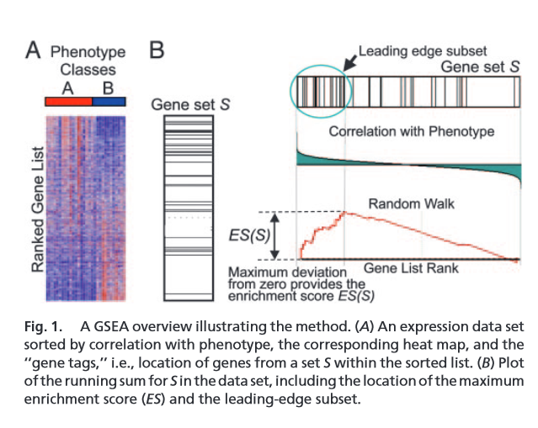
Gene Set Enrichment Analysis
Increased Expression
Decreased Expression
(2005, PNAS 102, 15545-15550)

Slide 44
Gene sets concordantly expressed in all psychiatric disorders in postmortem brain
 |  | Schizophrenia |  |  |  | Bipolar Disorder |  |  |  | Depression
 |  | hippocampus |  | orbitofrontal |  | hippocampus |  | orbitofrontal |  | orbitofrontal
Gene Set | size | NES | FDR | NES | FDR | NES | FDR | NES | FDR | NES | FDR
PEPTIDE CHAIN ELONGATION | 85 | 2.79 | 0.002 | 2.88 | 0 | 7.06 | 0 | 7.17 | 0 | 8.21 | 0
RIBOSOME | 86 | 2.70 | 0.003 | 3.07 | 0 | 6.88 | 0 | 7.31 | 0 | 7.93 | 0
INFLUENZA VIRAL RNA TRANSCRIPTION AND REPLICATION | 101 | 2.44 | 0.007 | 2.77 | 0.001 | 6.55 | 0 | 6.90 | 0 | 7.90 | 0
3 UTR MEDIATED TRANSLATIONAL REGULATION | 104 | 2.69 | 0.003 | 2.53 | 0.003 | 6.37 | 0 | 6.49 | 0 | 7.31 | 0
NONSENSE MEDIATED DECAY ENHANCED BY THE EXON JUNCTION COMPLEX | 106 | 2.66 | 0.003 | 2.66 | 0.001 | 6.10 | 0 | 6.38 | 0 | 7.35 | 0
SRP DEPENDENT COTRANSLATIONAL PROTEIN TARGETING TO MEMBRANE | 108 | 2.43 | 0.008 | 2.36 | 0.008 | 5.69 | 0 | 6.70 | 0 | 7.16 | 0
TRANSLATION | 144 | 2.38 | 0.009 | 2.18 | 0.017 | 5.25 | 0 | 6.10 | 0 | 6.62 | 0
INFLUENZA LIFE CYCLE | 135 | 2.60 | 0.003 | 2.06 | 0.031 | 5.67 | 0 | 5.72 | 0 | 6.34 | 0
METABOLISM OF MRNA | 208 | 2.65 | 0.003 | 2.41 | 0.006 | 4.21 | 0 | 5.47 | 0 | 5.72 | 0
NEURONAL SYSTEM | 276 | -2.26 | 0.021 | -2.71 | 0.001 | -3.90 | 0 | -7.17 | 0 | -6.17 | 0
ANTIGEN PROCESSING UBIQUITINATION PROTEASOME DEGRADATION | 199 | -2.47 | 0.005 | -2.74 | 0.001 | -3.47 | 0 | -2.28 | 0.004 | -2.94 | 0
ENDOCYTOSIS | 179 | -3.60 | 0 | -2.42 | 0.005 | -2.56 | 0.002 | -2.46 | 0.001 | -2.20 | 0.01
GABA SYNTHESIS RELEASE REUPTAKE AND DEGRADATION | 17 | -2.70 | 0.001 | -1.88 | 0.047 | -2.75 | 0.001 | -2.36 | 0.002 | -3.04 | 0
Normalized enrichment score (NES) = strength of enrichment
Negative = set is enriched among genes with decreased expression in psychiatric disease
Positive = set is enriched among genes with increased expression in psychiatric disease
FDR = False Discovery Rate q value
Notes:
Thirteen gene sets were enriched in the same direction in all disorders in both tissues. The number of genes in each gene set, the normalized enrichment score, and the false discovery rate q value for enrichment are shown here. Gene sets with predominately decreased expression in psychiatric disease are in red, while gene sets with predominately increased expression are in black.

Slide 45
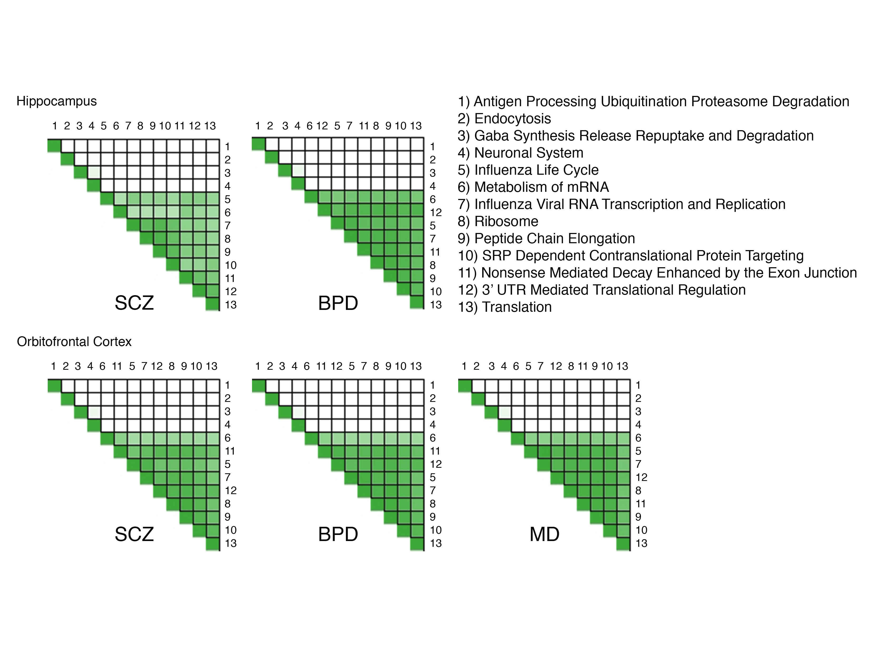
Notes:
Each of these plots is a heatmap of extent of overlap in the genes that are driving enrichment of each gene set. The top four gene sets are independent from each other in that the genes that drive their enrichment do not drive the enrichment of other sets.

Slide 46
Notes:
In contrast, there is a great deal of overlap of genes driving enrichment of the other nine gene sets. This does not mean that each individual function is not affected, but rather that a core set of genes is affecting many related functions. All of the other gene sets contain the majority of the genes in the Ribosome gene set, so I decided to look further at the expression of the ribosomal genes.

Slide 47
Relative Expression of Ribosomal Genes
BP vs Ctl | MD vs Ctl | SCZ vs Ctl | SCZ vs Ctl | BP vs Ctl
Orbitofrontal Cortex |  |  | Hippocampus
BP vs Ctl | MD vs Ctl | SCZ vs Ctl | SCZ vs Ctl | BP vs Ctl
Orbitofrontal Cortex |  |  | Hippocampus
Notes:
Since this gene set was originally identified by ranking of the wald statistic which combines fold change and significance, I plotted heat maps of the ribosomal genes using the log fold change (on the left) to show relative expression differences of each gene regardless of the significance of the change. Each row in the heat map represents a gene in the KEGG ribosome gene set, and each column indicates the relative expression of each diagnostic group relative to their matched controls. Increased expression is red while decreased expression is blue. Most of the genes in the ribosomal gene sets are overexpressed in all disorders although the strongest differences are in mood disorder samples. To show the significance of these changes regardless of the magnitude of the fold change, I also plotted the sign-adjusted log 10 transformed p value on the right. The most significant upregulation is in red while the most significant downregulation is in blue. By either measure it appears that the ribosomal genes are predominantly upregulated in all conditions.

Slide 48
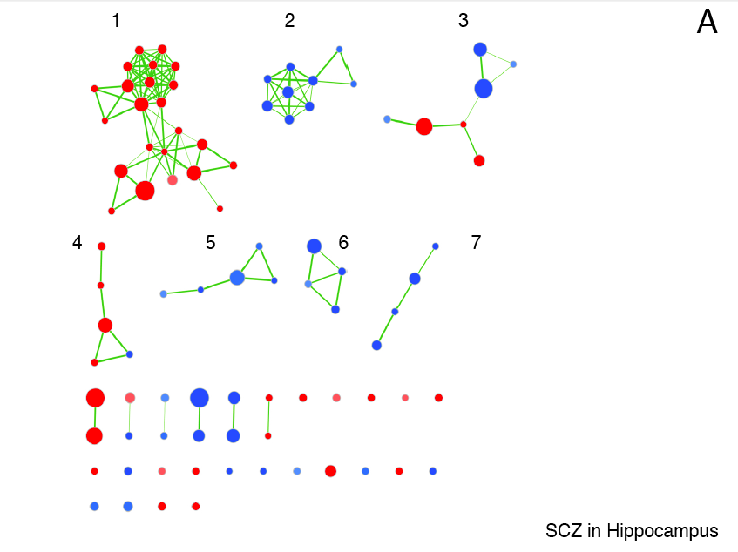

Slide 49
Two Different Approaches
Gene Set Expression Analysis
Repetitive Element Loci
High sample-to-sample variability
Small expression differences
Different genes in different individuals
Genes in same pathway = same symptoms
Core deficits
Common across diagnoses
Common across brain regions
HG19 Repeat Database: 5,298,130 genomic regions
More than 50% of genome
Multiple copies of highly similar DNA sequences
Left over from transposition
Most immobilized
97% have unique region
Expressed in cortex but specific loci unknown
Might be functional
Notes:
Overexpression of Alu (retrotransposon) RNA causes toxicity in age related macular degeneration
Expression of HERV-W altered in schizophrenia, bipolar disorder, and depression

Slide 50
Methods Overview
Sequence RNA from large number of brains
Hippocampus or orbitofrontal cortex
SCZ, BPD, or MDD and matched controls
Align sequencing reads to genome
Count reads aligning to each gene
In each brain region, identify genes differentially expressed in each diagnostic group relative to control
Find functionally related gene sets with disproportionately increased or decreased expression
Focus on gene sets consistently perturbed across brain regions and diagnostic groups.

Slide 51
Demographic information for samples included in expression analysis
Stanley Array Collection
Stanley Neuropathology Consortium
 | Hippocampus |  |  | Orbitofrontal Cortex
Factor | SCZ | BPD | Controls | SCZ | BPD | MD | Controls
Number | 35 | 33 | 32 | 13 | 14 | 15 | 15
Age | 42.6 | 45.4C | 43.9 | 44.65 | 41.9 | 46.5 | 48.1
 | (19-59) | (19-64) | (31-60) | (25-62) | (25-61) | (30-65) | (29-68)
Sex | 9F, 26M | 18F, 15M | 9F, 24M | 8M, 5F | 9M, 5F | 9M, 6F | 9M, 6F
Race | 34C, 1H | 32C, 1NA | 32C | 10C, 3A | 13C, 1AA | 15C | 14C, 1AA
PMI (h) | 31.4 | 38 | 30 | 35.8 | 30.9 | 27.5 | 23.7
 | (9-80) | (12-84) | (9-58) | (12-61) | (13-62) | (7-47) | (8-42)
pH | 6.5 | 6.4 | 6.6 | 6.2 | 6.2 | 6.2 | 6.3
 | (5.9-6.9) | (5.8-7) | (6-7) | (5.8-6.6) | (5.8-6.5) | (5.8-6.5) | (5.8-6.6)
Side | 17L, 18R | 18L, 15R | 15L, 17R | 8L, 5R | 6L, 8R | 9L, 6R | 8L, 7R
100 total
57 total
Notes:
As Sarven mentioned, we sequenced RNA from the hippocampus of brains in the Stanley Microarray Collection and from the orbitofrontal cortex of brains in the Stanley Neuropathology Consortium. I’m sure that you are all familiar with these collections, so I will simply mention that after outlier removal we included 100 hippocampal samples and 57 orbitofrontal cortex samples in the final analysis and the controls remained well matched to each diagnostic group

Slide 52
 | Hippocampus |  |  | Orbitofrontal Cortex
Factor | SCZ | BPD | Controls | SCZ | BPD | MD | Controls
Number | 35 | 33 | 32 | 13 | 14 | 15 | 15
Age | 42.6 | 45.4 | 43.9 | 44.7 | 41.9 | 46.5 | 48.1
 | (19-59) | (19-64) | (31-60) | (25-62) | (25-61) | (30-65) | (29-68)
Sex | 9F, 26M | 18F, 15M | 9F, 24M | 8M, 5F | 9M, 5F | 9M, 6F | 9M, 6F
Race | 34C, 1H | 32C, 1NA | 32C | 10C, 3A | 13C, 1AA | 15C | 14C, 1AA
PMI (h) | 31.4 | 38 | 30 | 35.8 | 30.9 | 27.5 | 23.7
 | (9-80) | (12-84) | (9-58) | (12-61) | (13-62) | (7-47) | (8-42)
pH | 6.5 | 6.4 | 6.6 | 6.2 | 6.2 | 6.2 | 6.3
 | (5.9-6.9) | (5.8-7) | (6-7) | (5.8-6.6) | (5.8-6.5) | (5.8-6.5) | (5.8-6.6)
Side | 17L, 18R | 18L, 15R | 15L, 17R | 8L, 5R | 6L, 8R | 9L, 6R | 8L, 7R
No
Antipsychotics
Notes:
Not Addicts

Slide 53
Notes:
A few genes were significant on each list, but no single gene reached significance across the three disorders. We then ranked all genes according to the strength and direction of differential expression using the wald test statistic provided by DESeq2. The most significant genes with increased expression are at the top of the list while the most significant genes with decreased expression are at the bottom of the list. We performed gene set enrichment analysis to identify canonical pathway gene sets with a disproportionate number of genes at the top or bottom of each list.

Slide 54
Increased Expression
Most Significant
Upregulated
Most Significant
Downregulated
Decreased Expression
Notes:
We then ranked all genes according to the strength and direction of differential expression using the wald test statistic provided by DESeq2. The most significant genes with increased expression are at the top of the list while the most significant genes with decreased expression are at the bottom of the list. We performed gene set enrichment analysis to identify canonical pathway gene sets with a disproportionate number of genes at the top or bottom of each list.

Slide 55
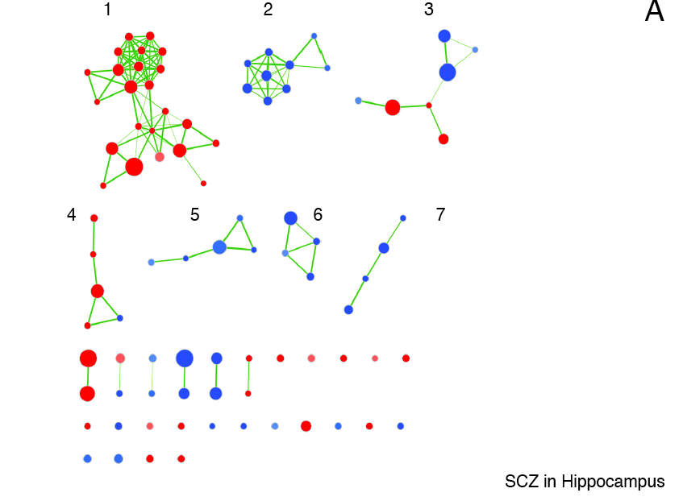

Slide 56
Gene sets concordantly expressed in all psychiatric disorders in postmortem brain
 |  | Schizophrenia |  |  |  | Bipolar Disorder |  |  |  | Depression
 |  | hippocampus |  | orbitofrontal |  | hippocampus |  | orbitofrontal |  | orbitofrontal
Gene Set | size | NES | FDR | NES | FDR | NES | FDR | NES | FDR | NES | FDR
PEPTIDE CHAIN ELONGATION | 85 | 2.79 | 0.002 | 2.88 | 0 | 7.06 | 0 | 7.17 | 0 | 8.21 | 0
RIBOSOME | 86 | 2.70 | 0.003 | 3.07 | 0 | 6.88 | 0 | 7.31 | 0 | 7.93 | 0
INFLUENZA VIRAL RNA TRANSCRIPTION AND REPLICATION | 101 | 2.44 | 0.007 | 2.77 | 0.001 | 6.55 | 0 | 6.90 | 0 | 7.90 | 0
3 UTR MEDIATED TRANSLATIONAL REGULATION | 104 | 2.69 | 0.003 | 2.53 | 0.003 | 6.37 | 0 | 6.49 | 0 | 7.31 | 0
NONSENSE MEDIATED DECAY ENHANCED BY THE EXON JUNCTION COMPLEX | 106 | 2.66 | 0.003 | 2.66 | 0.001 | 6.10 | 0 | 6.38 | 0 | 7.35 | 0
SRP DEPENDENT COTRANSLATIONAL PROTEIN TARGETING TO MEMBRANE | 108 | 2.43 | 0.008 | 2.36 | 0.008 | 5.69 | 0 | 6.70 | 0 | 7.16 | 0
TRANSLATION | 144 | 2.38 | 0.009 | 2.18 | 0.017 | 5.25 | 0 | 6.10 | 0 | 6.62 | 0
INFLUENZA LIFE CYCLE | 135 | 2.60 | 0.003 | 2.06 | 0.031 | 5.67 | 0 | 5.72 | 0 | 6.34 | 0
METABOLISM OF MRNA | 208 | 2.65 | 0.003 | 2.41 | 0.006 | 4.21 | 0 | 5.47 | 0 | 5.72 | 0
NEURONAL SYSTEM | 276 | -2.26 | 0.021 | -2.71 | 0.001 | -3.90 | 0 | -7.17 | 0 | -6.17 | 0
ANTIGEN PROCESSING UBIQUITINATION PROTEASOME DEGRADATION | 199 | -2.47 | 0.005 | -2.74 | 0.001 | -3.47 | 0 | -2.28 | 0.004 | -2.94 | 0
ENDOCYTOSIS | 179 | -3.60 | 0 | -2.42 | 0.005 | -2.56 | 0.002 | -2.46 | 0.001 | -2.20 | 0.01
GABA SYNTHESIS RELEASE REUPTAKE AND DEGRADATION | 17 | -2.70 | 0.001 | -1.88 | 0.047 | -2.75 | 0.001 | -2.36 | 0.002 | -3.04 | 0
Normalized enrichment score (NES) = strength of enrichment
Negative = set is enriched among genes with decreased expression in psychiatric disease
Positive = set is enriched among genes with increased expression in psychiatric disease
FDR = False Discovery Rate q value
Notes:
Thirteen gene sets were enriched in the same direction in all disorders in both tissues. The number of genes in each gene set, the normalized enrichment score, and the false discovery rate q value for enrichment are shown here. Gene sets with predominately decreased expression in psychiatric disease are in red, while gene sets with predominately increased expression are in black.

Slide 57
Notes:
Each of these plots is a heatmap of extent of overlap in the genes that are driving enrichment of each gene set. The top four gene sets are independent from each other in that the genes that drive their enrichment do not drive the enrichment of other sets.

Slide 58
Notes:
In contrast, there is a great deal of overlap of genes driving enrichment of the other nine gene sets. This does not mean that each individual function is not affected, but rather that a core set of genes is affecting many related functions. All of the other gene sets contain the majority of the genes in the Ribosome gene set, so I decided to look further at the expression of the ribosomal genes.

Slide 59
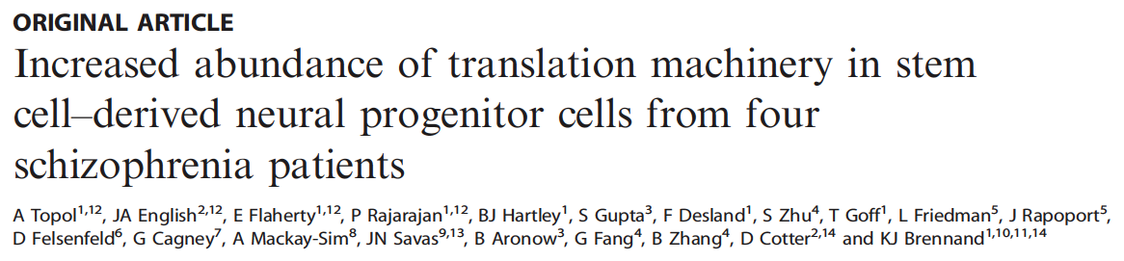


Translational Psychiatry (2015) 5, e662; doi:10.1038/tp.2015.118; published online 20 October 2015
Molecular Psychiatry (2015), advance online publication, 16 June 2015; doi:10.1038/mp.2015.79
Notes:
Although we saw the strongest increase in ribosomal gene expression in the mood disorder samples, dysregulation of ribosomal genes has previously been implicated in schizophrenia. The same group has recently published two papers in the same issue of Translational psychiatry. One describes an increase of ribosomal protein abundance in stem cell derived neural progenitor cells from four schizophrenia patients. The other describes decreased abundance of ribosomal proteins in schizophrenia patient-derived olfactory cells, suggesting that dysregulation of ribosomal proteins could be cell type specific.
Our observation of increased expression of ribosomal protein genes in the hippocampus agrees with the results that Dr. Kim described yesterday, since a module of genes with increased expression in schizophrenia was enriched for ribosomal genes.

Slide 60
Conclusions
Concordant dysregulation of functionally related genes.
Two postmortem brain regions
Schizophrenia, bipolar disorder, and major depression.
Some processes previously implicated in at least one disorder
Neuronal systems, GABAergic signaling, adaptive immunity
We provide evidence in all three disorders
Potential roles for mRNA processing and translation in schizophrenia, bipolar disorder, and major depression.
Notes:
In conclusion, we have identified functionally related sets of genes that are concordantly overexpressed or underexpressed in the hippocampus and orbitofrontal cortex in schizophrenia, bipolar disorder, and major depression.
Many of the processes described by these gene sets--such as neuronal systems, GABAergic signaling, and adaptive immunity--have previously been implicated in at least one disorder, but we now provide evidence that expression of these genes is perturbed in all three disorders.
Our findings also highlight potential roles for mRNA processing and translation in schizophrenia, bipolar disorder, and major depression.
In the future it would be interesting to reexamine GWAS results in the context of the concordantly regulated pathways that we have identified to see whether any of the polymorphisms that associate with multiple psychiatric disorders correlate with expression of these sets of genes.
I am also very interested to examine the causes of ribosomal overexpression and the potential effects on mRNA processing and translation. In particular, mRNA processing functions such as nonsense mediated decay (which identifies and degrades transcripts with erroneous stop codons) may contribute to psychiatric disease.

Slide 61
Extra slides

Slide 62
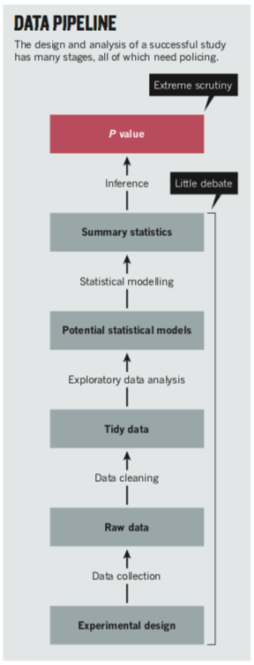
Data Analysis For Reproducibility
Organization
Communication
Oversight

Slide 63
Data Analysis For Reproducibility
Data integrity
Data protection/preservation
Verification?

Slide 64
Data Analysis For Reproducibility
Typos
Bad characters
Missing values
Column/row shifts
Off by one?
Consistent labeling

Slide 65
Data Analysis For Reproducibility
Confirm data is ready to be analyzed

Slide 66
Data Analysis For Reproducibility
What does the data look like?
Sanity checks – does it make sense?
Principal Components Analysis
Heatmaps
Obvious outliers?
Obvious patterns that correlate with treatment?
Obvious patterns that correlate with potential confounds?

Slide 67
MA plot

Slide 68
P value histogram

Slide 69
Data Analysis For Reproducibility
Does the model fit the “shape” of the data?
Parametric vs nonparametric
Obvious outliers?
What experimental factors could affect the outcome?
Can we model the effects of treatments and confounds?

Slide 70
PCA Prior to Differential Expression

Slide 71
Sample Distance Heat Map

Slide 72
Data Analysis For Reproducibility
Does the model fit the “shape” of the data?
Parametric vs nonparametric
What experimental factors could affect the outcome?
Can we model the effects of treatments and confounds?
Decisions based on exploratory data analysis – show evidence

Slide 73
Simple check for skew of the data: scatter plot

Slide 74
Data Analysis For Reproducibility
Apply the models
Check the models
Correct the models
False discovery rate
Multiple testing correction

Slide 75
Data Analysis For Reproducibility
Reporting of the outcomes
Clear rules spelled out in detail
Cutoffs, significance thresholds
Test statistic such as “wald” or “f”
Degrees of freedom
Effect size
Overall variance

Slide 76
Data Analysis For Reproducibility
p value is small part
Honest interpretation including potential weaknesses
Do not overstate effects
Support with data visualization i.e. scatter plots.
Example: p value not always full story

Slide 77
Stop Here

Slide 78
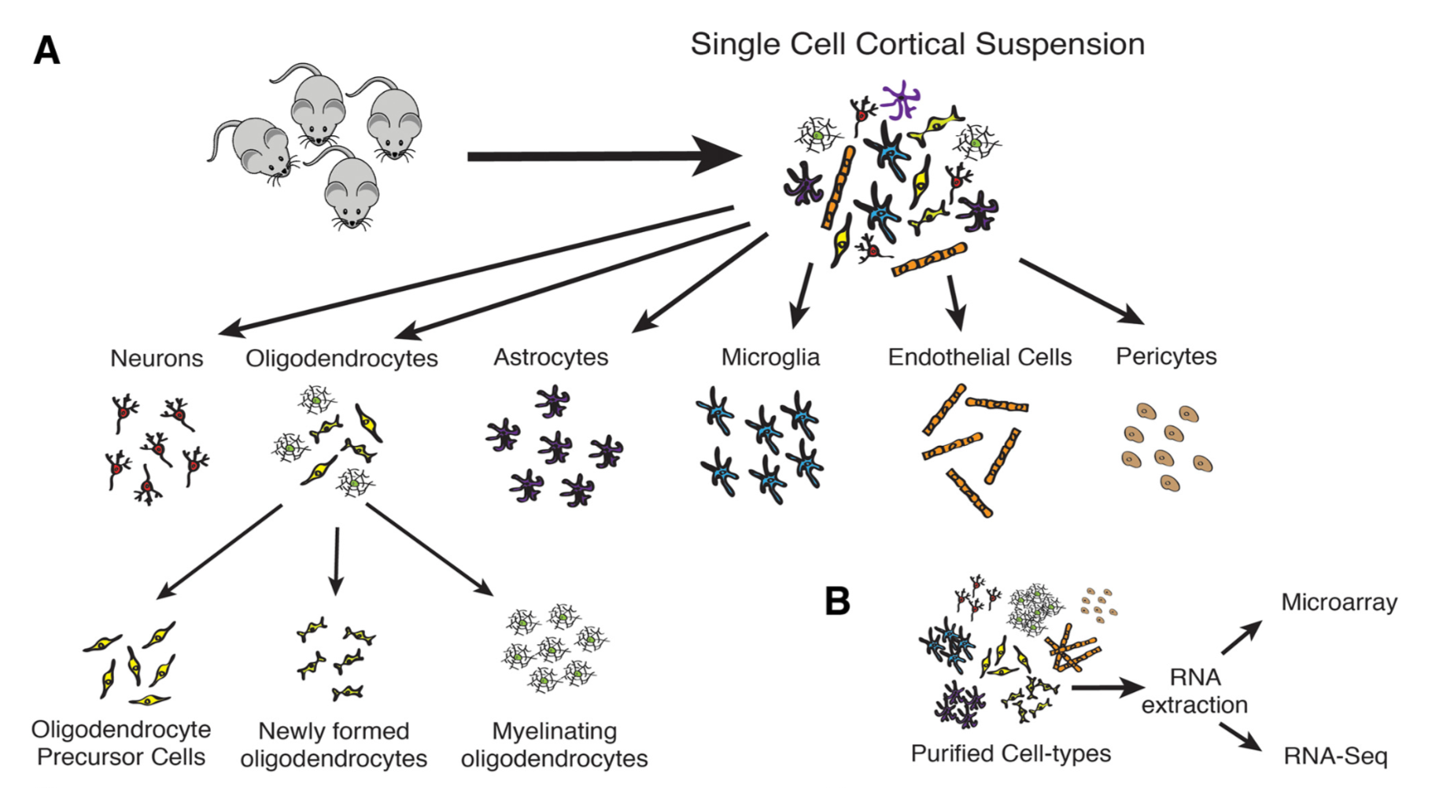
Sample selection and Library Prep
J. Neurosci., September 3, 2014 • 34(36):11929 –11947

